Slide 1
EVOLVING ARCHITECTURE WITH DDD AND HYPERMEDIA
@EINARWH

Slide 2


Slide 3
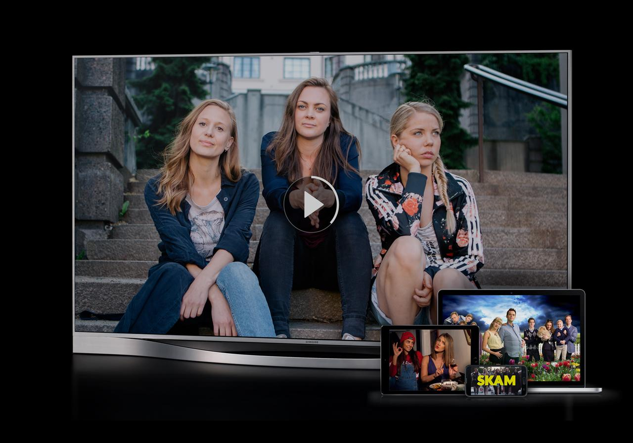

Slide 4
WHY HYPERMEDIA?

Slide 5
BECAUSE IT’S IN VOGUE?

Slide 6
BECAUSE I LIKE IT?

Slide 7
NO!

Slide 8
BECAUSE IT HELPS US!

Slide 9
HYPERMEDIA AS ENABLER FOR BETTER ARCHITECTURE

Slide 10
THIS IS AN ARCHITECTURE TALK

Slide 11
STRANGLING THE MONOLITH WITH HYPERMEDIA

Slide 12
AGENDA

Slide 13
ARCHITECTURE CHALLENGES AT NRK TV

Slide 14
INTRODUCTION TO HYPERMEDIA

Slide 15
HYPERMEDIA IN PRACTICE AT NRK TV

Slide 16
HYPERMEDIA IS ABOUT ARCHITECTURE

Slide 18
ARCHITECTURE CONCERNS AT NRK TV

Slide 19
SOCIO-TECHNICAL CONTEXT

Slide 20
BUSINESS PERSPECTIVE

Slide 21
RAPIDLY EVOLVING DOMAIN

Slide 22
MUST STAY COMPETITIVE

Slide 23
MUST BE NIMBLE

Slide 24
ORGANIZATION

Slide 25
MULTIPLE TEAMS AT NRK TV

Slide 26
COLLABORATION WITH NRK RADIO AND NRK SUPER

Slide 27
INTERACTIONS WITH OTHER PARTS OF THE ORGANIZATION

Slide 28
A SYSTEM IN A SYSTEM OF SYSTEMS

Slide 29
WE MUST SUPPORT AUTONOMY

Slide 30
WE MUST SUPPORT EXPERIMENTS

Slide 31
WE MUST SUPPORT CHANGE

Slide 32
WE MUST PROVIDE STABILITY

Slide 33
WE MUST IMPROVE STABILITY

Slide 34
TECHNICAL PERSPECTIVE

Slide 35
THE NRK TV PLAYER API

Slide 36
MANY CLIENTS

Slide 37
PROGRESSIVE CLIENTS

Slide 38
LEGACY CLIENTS

Slide 39
IMPACT ON ARCHITECTURE

Slide 40
CA 2016

Slide 41
MONOLITHIC WEB API SERVING MANY CLIENTS

Slide 42
RUNS IN AZURE TWO DATA CENTERS

Slide 43
BACKED BY RELATIONAL DATABASE

Slide 44
VARIOUS SUPPORTING WORKER JOBS

Slide 45
CUNNING CACHING SCHEMES

Slide 46
OVERWHELMING COMPLEXITY

Slide 47
LARGELY UNREASONABLE

Slide 48
COMPLEX FAILURE MODES

Slide 49
UNFORESEEN EFFECTS OF CHANGE

Slide 50
BUGS

Slide 51
FEAR OF CHANGE

Slide 52
STAGNATION

Slide 53
RELIANCE ON RELEASE MANAGER GENIUS

Slide 54
WHAT TO DO?

Slide 55
REWRITE?

Slide 56
WHAT DO YOU MEAN REWRITE?

Slide 57
WE CAN’T REWRITE!

Slide 58
SO HOW DO WE REWRITE?

Slide 59
WE MUST EVOLVE!

Slide 61
WHERE DID THE MONOLITH COME FROM?

Slide 62
THE ENTITY

Slide 63
THE ENTITY IS THE MONOLITH

Slide 64
THE ENTITY SNOWBALLS COMPLEXITY

Slide 65
THE ENTITY IS THE BIG BALL OF MUD

Slide 66
FOR NRK TV THE TV SHOW IS THE ENTITY

Slide 67
ACCESSIBILITY
LIVE
MEDIA MANIFEST
BINGE WATCHING
AGE RATING
IMAGES
USAGE RIGHTS
TRAILERS
EPISODES
FAVORITES
PROMOTIONS
TV
SHOW
TV
SHOW
ON DEMAND
HIT TITLES
REPORTING
AGE CONTROL
SUBTITLES
CATEGORY
RECOMMENDATIONS
HISTORY
CONTRIBUTORS
SERIES
POPULARITY

Slide 68
WHAT IS A TV SHOW?

Slide 69
WHO’S ASKING?

Slide 70
FUNCTIONAL DECOMPOSITION

Slide 71
BOUNDED CONTEXTS

Slide 72
TV SHOW IN THE CATALOG CONTEXT

Slide 73
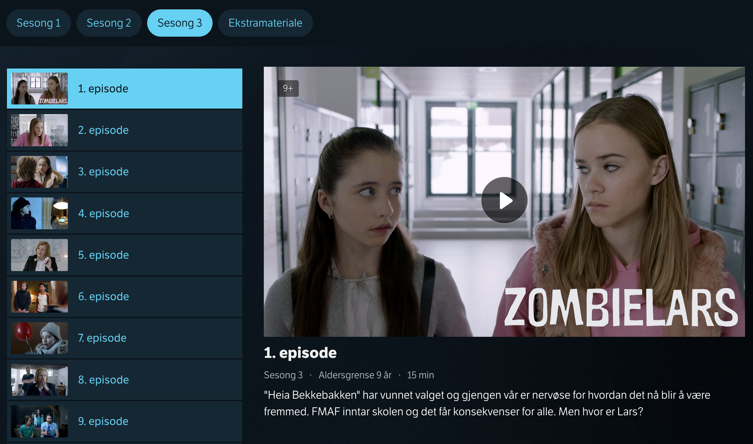

Slide 74
COMPLEXITY WITH RESPECT TO

Slide 75
METADATA DESCRIBING THE MEDIA CONTENT

Slide 76
WHAT KINDS OF TV SHOWS ARE THERE?

Slide 77
HOW SHOULD THEY BE PRESENTED?

Slide 78
WHAT’S THEIR LOGIC?

Slide 79
A TV SERIES WITH EPISODES IS DIFFERENT FROM THE DAILY NEWS IS DIFFERENT FROM A SPORTS EVENT IS DIFFERENT FROM A TALK SHOW IS DIFFERENT FROM A DOCUMENTARY IS DIFFERENT FROM …

Slide 80
DIFFERENT CONTENT IS CONSUMED DIFFERENTLY

Slide 81
TV SHOW IN THE PLAYBACK CONTEXT

Slide 82
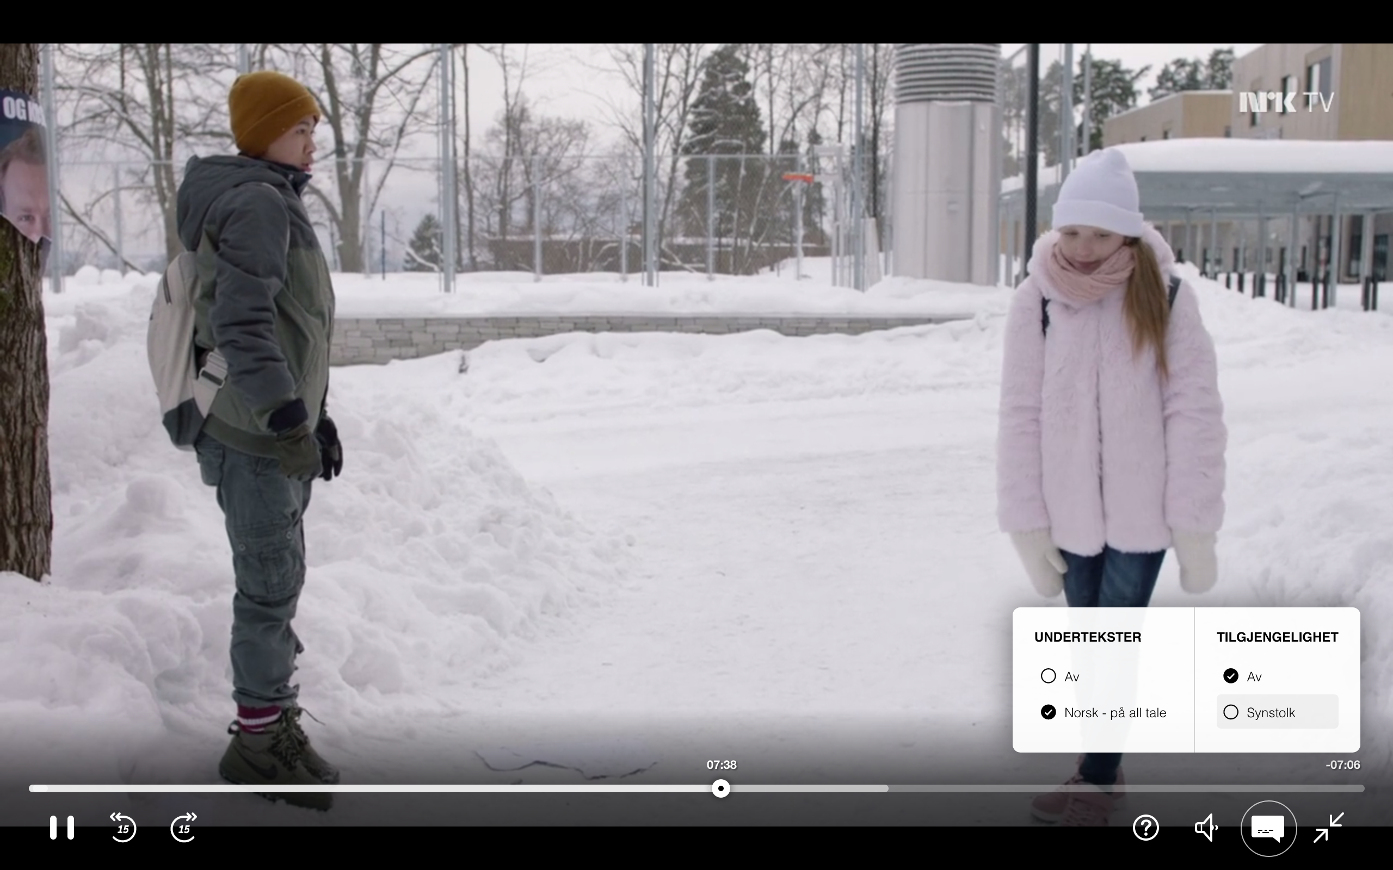

Slide 83
COMPLEXITY WITH RESPECT TO

Slide 84
PLAYING THE ACTUAL MEDIA CONTENT

Slide 85
SUPPORT FOR VARIOUS KINDS OF MEDIA MANIFESTS

Slide 86
STREAMING QUALITY

Slide 87
ADAPTING BIT RATE TO DEVICE AND NETWORK

Slide 88
SUPPORTING ACCESSIBILITY VERSIONS

Slide 89
WHAT ABOUT OTHER CONTEXTS?

Slide 90
CATALOG
DESKING
SEARCH
TV
SHOW
RECOMMEND
ATIONS
PERSONAL IZATION
PLAYBACK

Slide 91
CONTAINMENT OF COMPLEXITY

Slide 92
DIFFERENT GOALS AND REQUIREMENTS

Slide 93
CATALOG
DESKING
SEARCH
TV
SHOW
RECOMMEND
ATIONS
PERSONAL IZATION
PLAYBACK

Slide 94
CATALOG
DESKING
SEARCH
CRITICALITY?
TV
SHOW
RECOMMEND
ATIONS
PERSONAL IZATION
PLAYBACK

Slide 95
CATALOG
DESKING
SEARCH
TV
SHOW
RECOMMEND
ATIONS
PERSONAL IZATION
PLAYBACK

Slide 96
CATALOG
DESKING
SEARCH
TV
SHOW
RECOMMEND
ATIONS
PERSONAL IZATION
PLAYBACK

Slide 97
CATALOG
DESKING
SEARCH
TV
SHOW
RECOMMEND
ATIONS
PERSONAL IZATION
PLAYBACK

Slide 98
CATALOG
DESKING
SEARCH
CACHING?
TV
SHOW
RECOMMEND
ATIONS
PERSONAL IZATION
PLAYBACK

Slide 99
CATALOG
DESKING
SEARCH
TV
SHOW
RECOMMEND
ATIONS
PERSONAL IZATION
PLAYBACK

Slide 100
CATALOG
DESKING
SEARCH
TV
SHOW
RECOMMEND
ATIONS
PERSONAL IZATION
PLAYBACK

Slide 101
CATALOG
DESKING
SEARCH
TV
SHOW
RECOMMEND
ATIONS
PERSONAL IZATION
PLAYBACK

Slide 102
CATALOG
DESKING
SEARCH
FAILURES?
TV
SHOW
RECOMMEND
ATIONS
PERSONAL IZATION
PLAYBACK

Slide 103
CATALOG
DESKING
SEARCH
TV
SHOW
RECOMMEND
ATIONS
PERSONAL IZATION
PLAYBACK

Slide 104
CATALOG
DESKING
SEARCH
TV
SHOW
RECOMMEND
ATIONS
PERSONAL IZATION
PLAYBACK

Slide 105
UNIFORMLY CRITICAL

Slide 106
NOT EASILY CACHEABLE

Slide 107
NO PARTIAL SUCCESS

Slide 108
PRONE TO FAIL HARD

Slide 109
HARD TO REASON ABOUT

Slide 110
WHAT TO DO?

Slide 111
DELIBERATE ARCHITECTURE

Slide 112
LOBBIED FOR AND GOT AN ARCHITECT

Slide 113
BOUNDED CONTEXT AS SERVICE BOUNDARY

Slide 114
NEW STUFF AS NEW SERVICES

Slide 115
GATEWAY AS ARCHITECTURE SEAM

Slide 116
STRANGLER PATTERN

Slide 117
EXPERIMENT WITH HYPERMEDIA

Slide 118
RECOMPOSE WHAT WE DECOMPOSE

Slide 119
NAVIGATE SEAMLESSLY ACROSS BOUNDARIES

Slide 120
INTEGRATED EXPERIENCE

Slide 121
WHAT IS HYPERMEDIA?

Slide 122
MEDIA WITH LINKS

Slide 123
LINKS HAVE SEMANTICS

Slide 124
LINK RELATIONS

Slide 125
LINK PRESENCE IS DYNAMIC AND MEANINGFUL

Slide 126
LINKS TURN RESOURCES INTO JUNCTIONS

Slide 127
LINKS AS AFFORDANCES

Slide 128
LINKS ANSWER THE QUESTION: NOW WHAT?

Slide 129
THERE SHOULD BE A LINK FOR EACH WAY FORWARD

Slide 130
RESOURCES CONNECT TO FORM NARRATIVES

Slide 156
5XX

Slide 157
5XX

Slide 158
5XX

Slide 159
5XX

Slide 160
5XX

Slide 164
PLAYBACK
CATALOG
PERSONAL IZATION
DESKING

Slide 165
PLAYBACK
CATALOG
PERSONAL IZATION
DESKING

Slide 166
EVOLUTION & VERSIONING

Slide 167
THE CLASSICAL QUESTION: WHICH VERSIONING SCHEME?

Slide 168
NOT REALLY RELEVANT

Slide 169
RARELY USEFUL TO REPLACE INDIVIDUAL ENDPOINTS

Slide 170
OFFER NEW AND IMPROVED NARRATIVES

Slide 171
USE LINKS TO OFFER NEW ALTERNATIVES TO CLIENTS

Slide 172
IDENTIFY NARRATIVES BY LINK RELATIONS

Slide 173
LET THE CLIENT OPT-IN TO NEW ALTERNATIVES

Slide 174
WE CAN TRACK WHICH CLIENTS USE WHICH NARRATIVES

Slide 175
CLIENTS SELF-IDENTIFY THROUGH USER AGENT HEADER

Slide 176
EVENTUALLY REMOVE LINKS TO OBSOLETE NARRATIVES

Slide 177
CATALOG
PLAYBACK
PERSONAL IZATION
DESKING

Slide 178
LEGACY
CATALOG
PLAYBACK
PERSONAL IZATION
DESKING

Slide 179
LEGACY
CATALOG
PLAYBACK
EPISODE
SERIES
SERIES
PERSONAL IZATION
DESKING

Slide 180
LEGACY
CATALOG
PLAYBACK
EPISODE
SERIES
SERIES
PERSONAL IZATION
TV SHOW PAGES
DESKING

Slide 181
LEGACY
CATALOG
PLAYBACK
EPISODE
PROGRAMPAGE
SERIES
showpage
SERIES
PERSONAL IZATION
showpage
TV SHOW PAGES
DESKING

Slide 182
LEGACY
CATALOG
PLAYBACK
EPISODE
SERIES
SERIES
PERSONAL IZATION
DESKING

Slide 183
LEGACY
CATALOG
PLAYBACK
EPISODE
PROGRAMPAGE
SERIES
showpage
SERIES
PERSONAL IZATION
showpage
TV SHOW PAGES
DESKING

Slide 184
LEGACY
CATALOG
PLAYBACK
EPISODE
PROGRAMPAGE
SERIES
showpage
SERIES
PERSONAL IZATION
showpage
TV SHOW PAGES
DESKING

Slide 185
LEGACY
CATALOG
PLAYBACK
EPISODE
PROGRAMPAGE
SERIES
showpage
SERIES
PERSONAL IZATION
showpage
TV SHOW PAGES
DESKING

Slide 186
LEGACY
CATALOG
PLAYBACK
EPISODE
PROGRAMPAGE
SERIES
showpage
SERIES
PERSONAL IZATION
showpage
TV SHOW PAGES
DESKING

Slide 187
LEGACY
CATALOG
PLAYBACK
EPISODE
PROGRAMPAGE
SERIES
showpage
SERIES
PERSONAL IZATION
showpage
TV SHOW PAGES
DESKING

Slide 188
PLAYBACK
PROGRAMPAGE
showpage
PERSONAL IZATION
showpage
TV SHOW PAGES
DESKING

Slide 189
HYPERMEDIA FORMAT

Slide 190
HYPERMEDIA APPLICATION LANGUAGE

Slide 191
WHY HAL?

Slide 192
LIGHTWEIGHT

Slide 193
GRADUAL

Slide 194
RESOURCES HAVE LINKS AND STATE

Slide 195
LINKS HAVE A TARGET AND A RELATION

Slide 196
RESOURCES MAY HAVE EMBEDDED RESOURCES

Slide 197
HAL EXAMPLES

Slide 198
{
"_links":
{
"self":
{
"href": "tv/series/skam"
}
}
}

Slide 199
COLLECTION OF LINKS
{
"_links":
{
"self":
{
"href": "tv/series/skam"
}
}
}

Slide 200
{
"_links":
{
"self":
{
"href": "tv/series/skam"
}
}
}
LINK RELATION

Slide 201
{
"_links":
{
"self":
{
"href": "tv/series/skam"
}
}
}
TARGET

Slide 202
{
"_links":
{
"self":
{
"href": "tv/series/skam"
}
}
}
URI

Slide 203
COLLECTION OF LINKS
{
"_links": { "self": { "href": "/tv-show/1" }, "manifest": [{ "name": "default", "href": "/manifest/1" }, { "name": "synstolk", "href": "/manifest/2" }] }
}

Slide 204
{
"_links": { "self": { "href": "/tv-show/1" }, "manifest": [{ "name": "default", "href": "/manifest/1" }, { "name": "synstolk", "href": "/manifest/2" }] }
}
LINK RELATIONS

Slide 205
{
"_links": { "self": { "href": "/tv-show/1" }, "manifest": [{ "name": "default", "href": "/manifest/1" }, { "name": "synstolk", "href": "/manifest/2" }] }
}
NAME AS SECONDARY KEY

Slide 206
COLLECTION OF LINKS
{
"_links": { "self": {
"href": "/tv-show/1"
} "progress": { "href": "/progress/{user}/1", "templated": true } }
}

Slide 207
{
"_links": { "self": {
"href": "/tv-show/1"
} "progress": { "href": "/progress/{user}/1", "templated": true } }
}
LINK RELATIONS

Slide 208
{
"_links": { "self": {
"href": "/tv-show/1"
} "progress": { "href": "/progress/{user}/1", "templated": true } }
}
TEMPLATED LINK

Slide 209
COLLECTION OF EMBEDDED RESOURCES
{ "_embedded": {
"favorite": { "_links": { "self": {
"href": "/tv-show/1" }
}
} }
}

Slide 210
{ "_embedded": {
"favorite": { "_links": { "self": {
"href": "/tv-show/1" }
}
} }
}
LINK RELATION

Slide 211
{ "_embedded": {
"favorite": { "_links": { "self": {
"href": "/tv-show/1" }
}
} }
}
EMBEDDED RESOURCE

Slide 212
EXAMPLES tv.nrk.no

Slide 213

DESKING

Slide 214
DESKING
{ "series": { "_links": { "self": { "href": "/series/heimebane" }, "image": { "href": "https://gfx.nrk.no/GKrIe1kJr" } }, "usageRights": { "isGeoBlocked": false }
}
}
EMBEDDED SERIES RESOURCE

Slide 215
DESKING
{ "series": { "_links": { "self": { "href": "/series/heimebane" }, "image": { "href": "https://gfx.nrk.no/GKrIe1kJr" } }, "usageRights": { "isGeoBlocked": false }
}
}
GO TO CATALOG CONTEXT

Slide 216
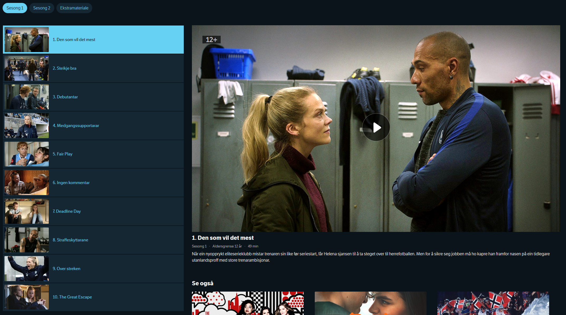
CATALOG

Slide 217
CATALOG
{ "_embedded": {
"episode": [{
"_links": {
"self": {
"href": "/programs/MDRI20000115"
},
"playback": {
"href": "/play/MDRI20000115"
},
"mediaelement": {
"href": "/mediaelement/MDRI20000115"
}, "share": {
"href": "https://tv.nrk.no/se? v=MDRI20000115{&autoplay,t}",
"templated": true
} },
"title": "1. Den som vil det mest", "productionYear": 2018, "rating": "12+", ... }] } }
EMBEDDED EPISODE RESOURCE

Slide 218
CATALOG
{ "_embedded": {
"episode": [{
"_links": {
"self": {
"href": "/programs/MDRI20000115"
},
"playback": {
"href": "/play/MDRI20000115"
},
"mediaelement": {
"href": "/mediaelement/MDRI20000115"
}, "share": {
"href": "https://tv.nrk.no/se? v=MDRI20000115{&autoplay,t}",
"templated": true
} },
"title": "1. Den som vil det mest", "productionYear": 2018, "rating": "12+", ... }] } }
GO TO PLAYBACK CONTEXT

Slide 219
CATALOG
{ "_embedded": {
"episode": [{
"_links": {
"self": {
"href": "/programs/MDRI20000115"
},
"playback": {
"href": "/play/MDRI20000115"
},
"mediaelement": {
"href": "/mediaelement/MDRI20000115"
}, "share": {
"href": "https://tv.nrk.no/se? v=MDRI20000115{&autoplay,t}",
"templated": true
} },
"title": "1. Den som vil det mest", "productionYear": 2018, "rating": "12+", ... }] } }
LEGACY PLAYBACK OPTION

Slide 220
CATALOG
{ "_embedded": {
"episode": [{
"_links": {
"self": {
"href": "/programs/MDRI20000115"
},
"playback": {
"href": "/play/MDRI20000115"
},
"mediaelement": {
"href": "/mediaelement/MDRI20000115"
}, "share": {
"href": "https://tv.nrk.no/se? v=MDRI20000115{&autoplay,t}",
"templated": true
} },
"title": "1. Den som vil det mest", "productionYear": 2018, "rating": "12+", ... }] } }
SHARE LINK TO EPISODE

Slide 221
CATALOG
{ "_embedded": {
"episode": [{
"_links": {
"self": {
"href": "/programs/MDRI20000115"
},
"playback": {
"href": "/play/MDRI20000115"
},
"mediaelement": {
"href": "/mediaelement/MDRI20000115"
}, "share": {
"href": "https://tv.nrk.no/se? v=MDRI20000115{&autoplay,t}",
"templated": true
} },
"title": "1. Den som vil det mest", "productionYear": 2018, "rating": "12+", ... }] } }
GO TO PLAYBACK CONTEXT

Slide 222
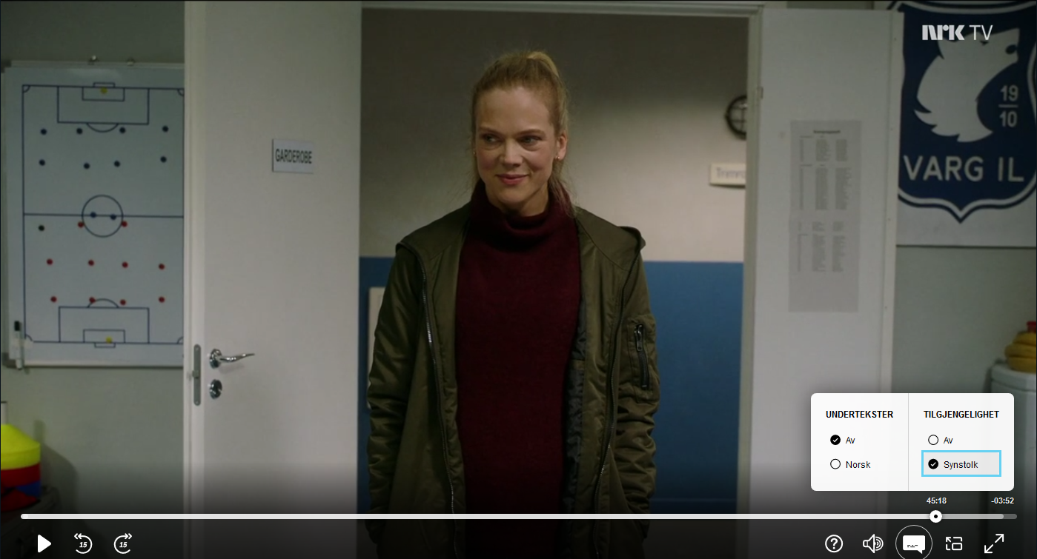
PLAYBACK
GO TO PLAYBACK CONTEXT

Slide 223
PLAYBACK
{ "_links": {
"self": {
"href": "/play/MDRI20000115"
},
"manifest": [{ "name": "default",
"href": "/manifest/MDRI20000115"
}, { "name": "synstolk",
"href": "/manifest/MDRI20000115SYNS"
}],
"next": {
"href": "/play/MDRI20000215" }, "series": {
"href": "/series/heimebane" }, "progress": {
"href": "/progress/{user}/MDRI20000215", "templated": true } }, "duration": "PT49M10.92S", ... }
EPISODE PLAYBACK RESOURCE
GO TO PLAYBACK CONTEXT

Slide 224
PLAYBACK
{ "_links": {
"self": {
"href": "/play/MDRI20000115"
},
"manifest": [{ "name": "default",
"href": "/manifest/MDRI20000115"
}, { "name": "synstolk",
"href": "/manifest/MDRI20000115SYNS"
}],
"next": {
"href": "/play/MDRI20000215" }, "series": {
"href": "/series/heimebane" }, "progress": {
"href": "/progress/{user}/MDRI20000215", "templated": true } }, "duration": "PT49M10.92S", ... }
RESOLVE MANIFEST URL
GO TO PLAYBACK CONTEXT

Slide 225
PLAYBACK
{ "_links": {
"self": {
"href": "/play/MDRI20000115"
},
"manifest": [{ "name": "default",
"href": "/manifest/MDRI20000115"
}, { "name": "synstolk",
"href": "/manifest/MDRI20000115SYNS"
}],
"next": {
"href": "/play/MDRI20000215" }, "series": {
"href": "/series/heimebane" }, "progress": {
"href": "/progress/{user}/MDRI20000215", "templated": true } }, "duration": "PT49M10.92S", ... }
ACCESSIBILITY OPTION
GO TO PLAYBACK CONTEXT

Slide 226
PLAYBACK
{ "_links": {
"self": {
"href": "/play/MDRI20000115"
},
"manifest": [{ "name": "default",
"href": "/manifest/MDRI20000115"
}, { "name": "synstolk",
"href": "/manifest/MDRI20000115SYNS"
}],
"next": {
"href": "/play/MDRI20000215" }, "series": {
"href": "/series/heimebane" }, "progress": {
"href": "/progress/{user}/MDRI20000215", "templated": true } }, "duration": "PT49M10.92S", ... }
PLAY NEXT EPISODE
GO TO PLAYBACK CONTEXT

Slide 227
PLAYBACK
{ "_links": {
"self": {
"href": "/play/MDRI20000115"
},
"manifest": [{ "name": "default",
"href": "/manifest/MDRI20000115"
}, { "name": "synstolk",
"href": "/manifest/MDRI20000115SYNS"
}],
"next": {
"href": "/play/MDRI20000215" }, "series": {
"href": "/series/heimebane" }, "progress": {
"href": "/progress/{user}/MDRI20000215", "templated": true } }, "duration": "PT49M10.92S", ... }
BACK TO CATALOG CONTEXT
GO TO PLAYBACK CONTEXT

Slide 228
PLAYBACK
{ "_links": {
"self": {
"href": "/play/MDRI20000115"
},
"manifest": [{ "name": "default",
"href": "/manifest/MDRI20000115"
}, { "name": "synstolk",
"href": "/manifest/MDRI20000115SYNS"
}],
"next": {
"href": "/play/MDRI20000215" }, "series": {
"href": "/series/heimebane" }, "progress": {
"href": "/progress/{user}/MDRI20000215", "templated": true } }, "duration": "PT49M10.92S", ... }
GO TO PLAYBACK CONTEXT
REPORT VIEWING PROGRESS

Slide 229
2020

Slide 230
THE MONOLITH IS SHRINKING

Slide 231
NO RELEASE MANAGER

Slide 232
INDEPENDENT DEPLOYS

Slide 233
PLAIN OLD HTTP CACHING

Slide 234
ALL NEW RESOURCES USE LINKS

Slide 235
MANY OLD RESOURCES HAVE LINKS

Slide 236
PHASED IN NEW SERVICES

Slide 237
PLAYBACK

Slide 238
TV SHOW PAGES

Slide 239
PERSONALIZATION

Slide 241
SUMMARY

Slide 242
DDD + HYPERMEDIA

Slide 243
USE BOUNDED CONTEXTS TO CONQUER COMPLEXITY

Slide 244
USE LINKS TO EVOLVE AND TO FORM NARRATIVES

Slide 245
WE CONTINUE TO EVOLVE

Slide 246
ARCHITECTURE IS NEVER DONE

